Slide 1
Team Hinton
Optical Digit Recognition (ODR)
Carisa Yao
Chandramouly Rathinasababathy
Ganesh Jothikumar
Hyunjung Byun
Jong Lin
Ravisankar Videla

Slide 2

Notes:
Cognitive psychologist and computer scientist- most of his research works in Artificial neural networks. He is teaching and works part time in Google Brain

Slide 3
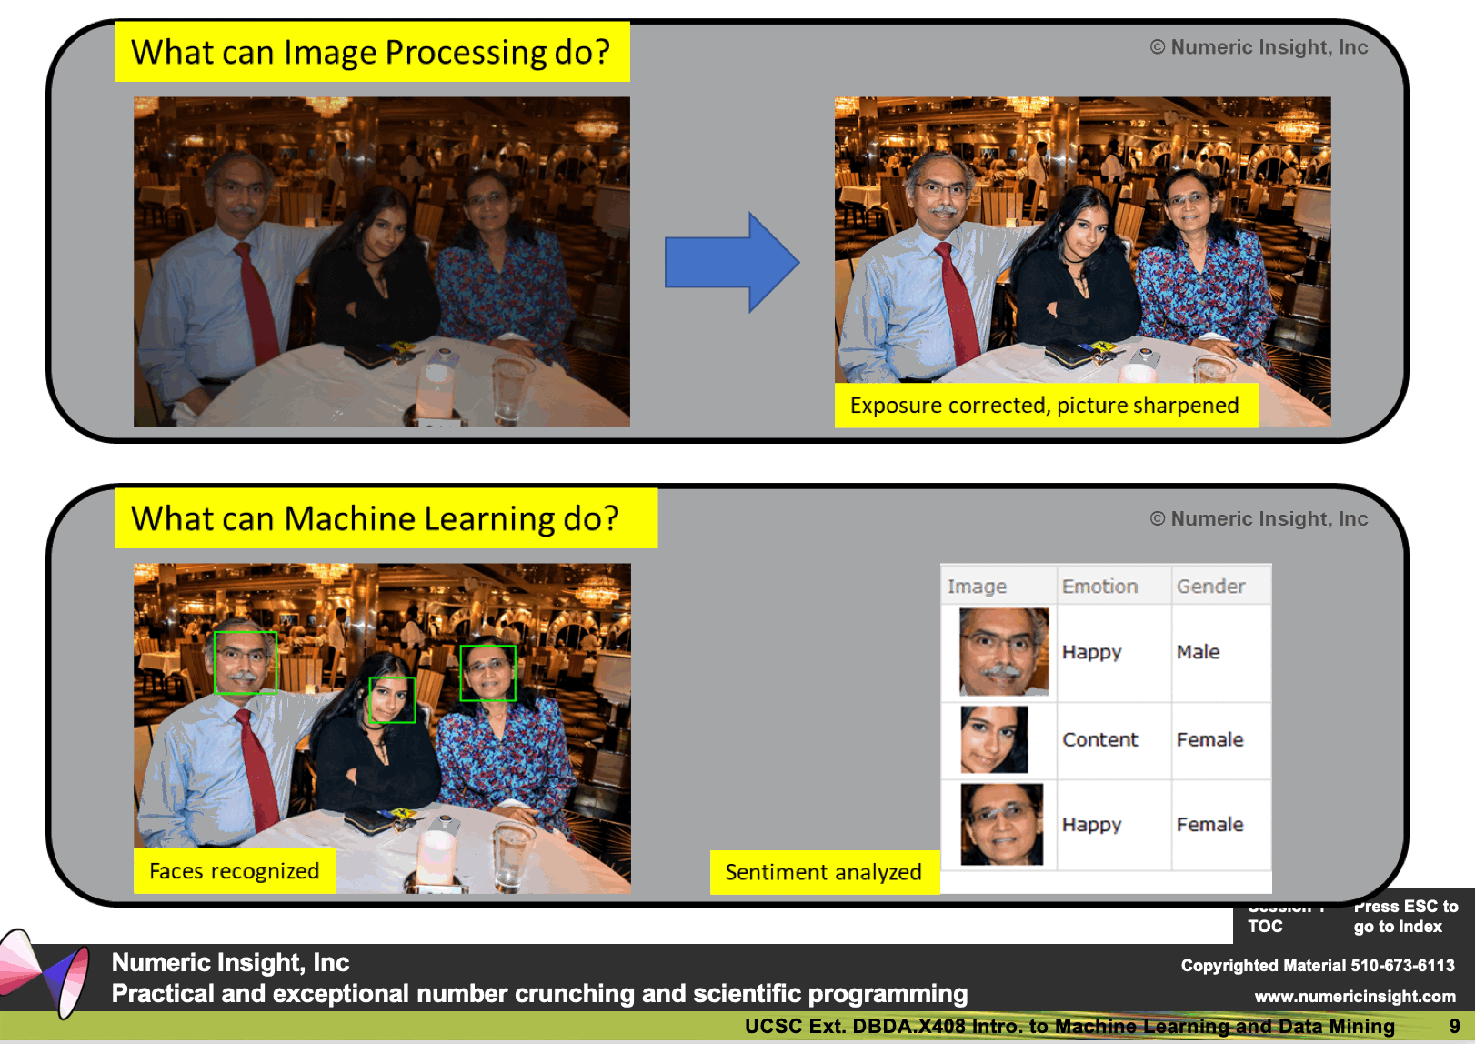
Machine Learning versus Other things

Slide 4

Notes:
Thailand- 310miles -2years

Slide 5
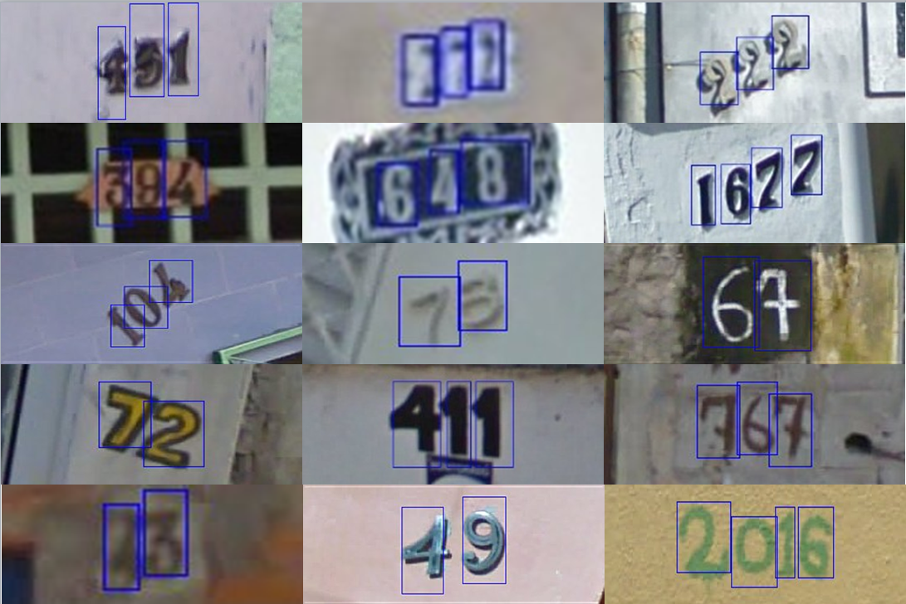
Problem Statement
Recognizing handwritten / printed numbers from an image
Practical applications include street view number identification

Slide 6
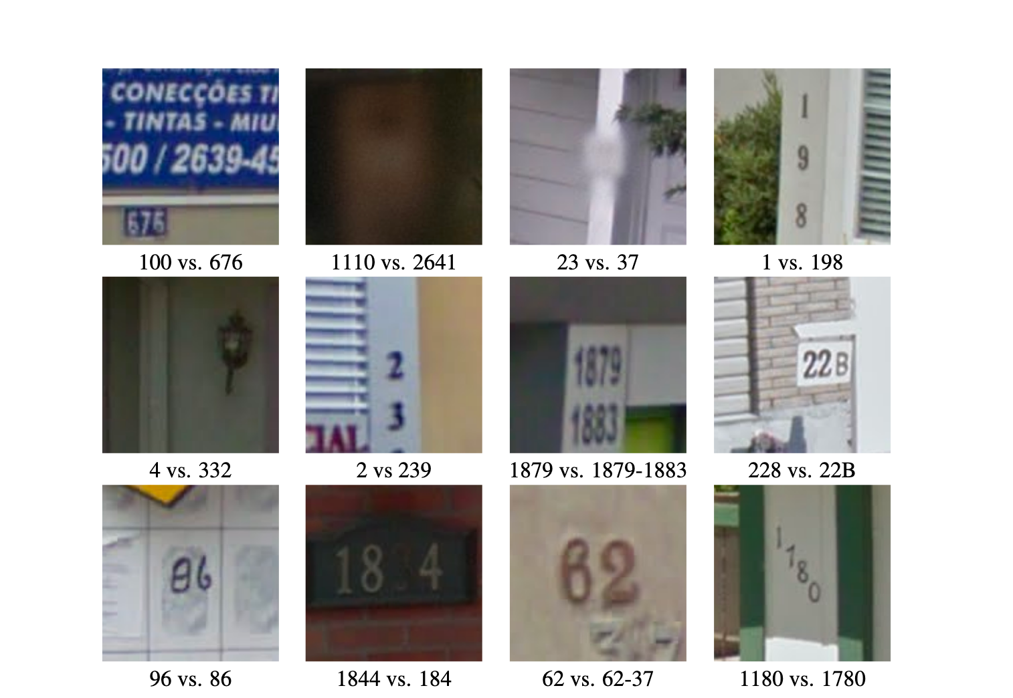
Some more patterns in street view

Slide 7
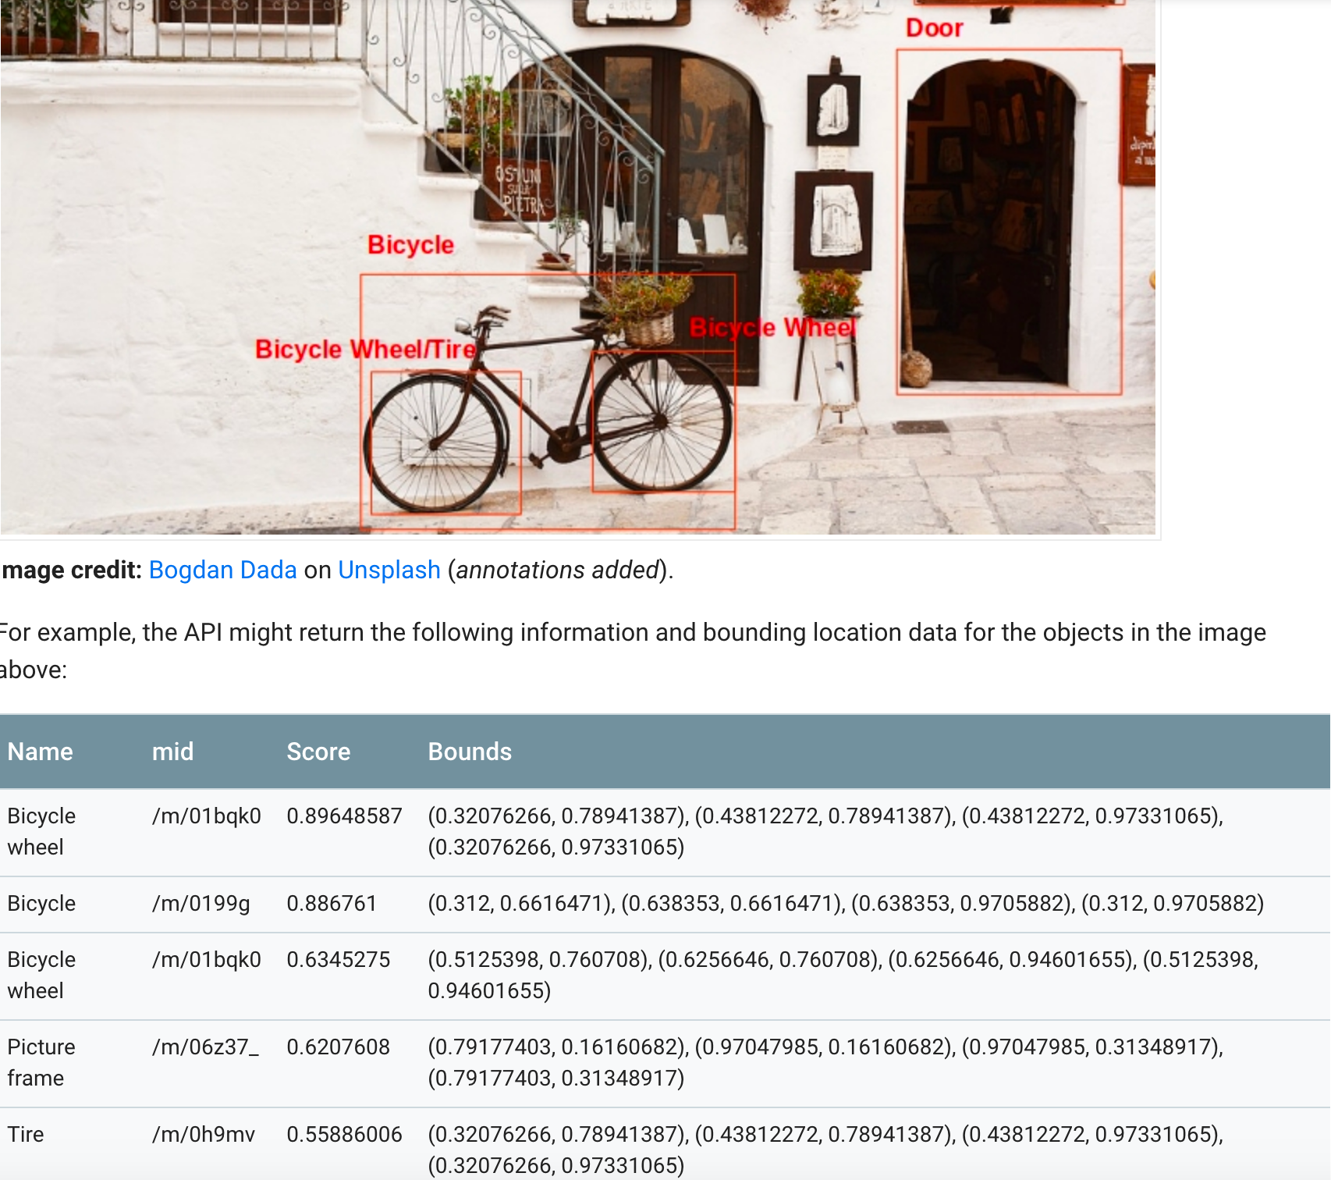
Extended Problem Space

Slide 8
Objective
Overall we tried to achieve the following through the course of this project
A technique to do the multi number detection with its bounding box from a given image.
Evaluate few classifiers and derive interesting findings

Slide 9
Dataset Challenges & Using MNIST
Realworld images from Google Street view imagery
Images not readily available for processing
Heavy preprocessing needed for consumption
Why we chose MNIST?
Core of the problem is number detection
MNIST is a rich resource for numbers
Can focus more on the problem and classification

Slide 10
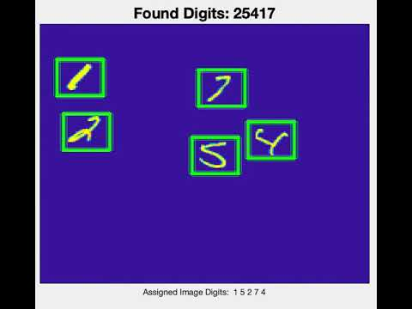
Demo - Video

Slide 11
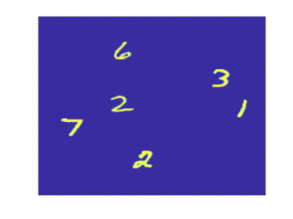
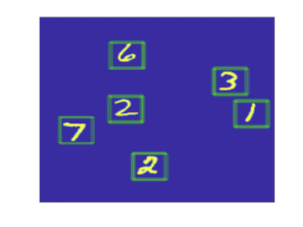

Demo - Screenshots

Slide 12
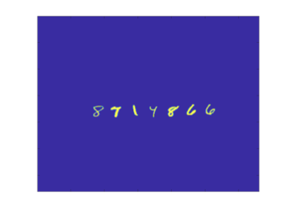
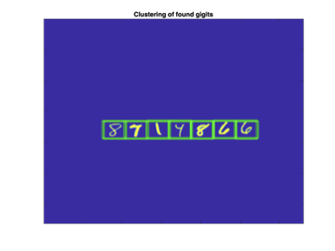
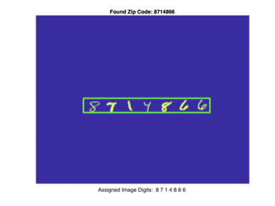
Demo - Screenshots

Slide 13
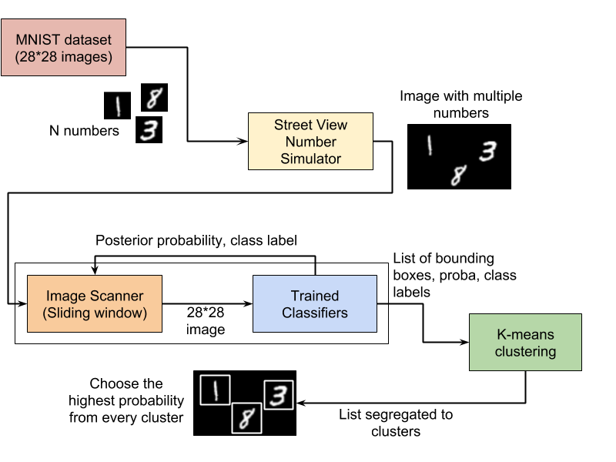
Overall Approach

Slide 14
Techniques Used
Image generator with random number of digits or address/zip code
Sliding window to search through image
Supervised learning classification to recognize digit, collect cluster of found digits
K-means and posterior probability to report address/zip code or digits with bounding box

Slide 15
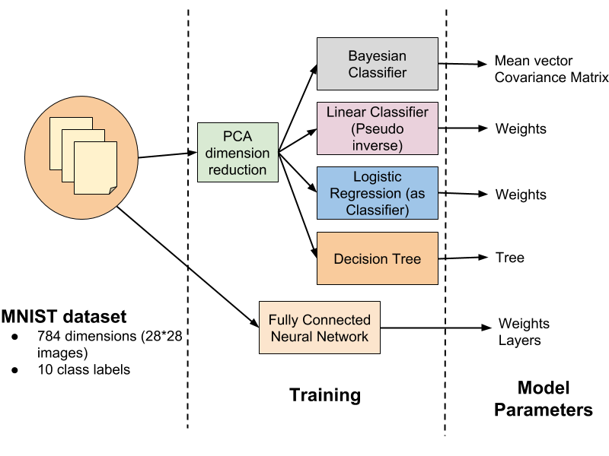
Supervised Learning - Classifiers

Slide 16
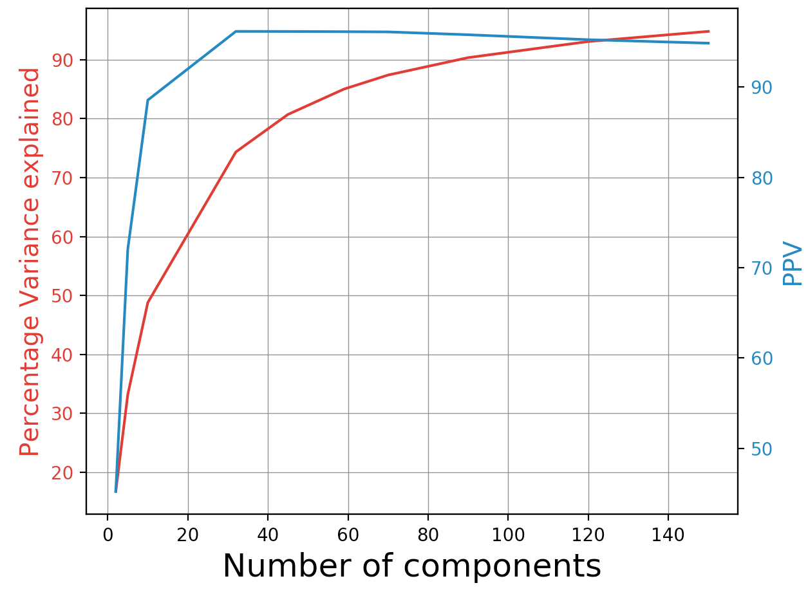
PCA Analysis
PCA determination through percentage of variance explained
Choice of optimal number of components based on PPV

Slide 17
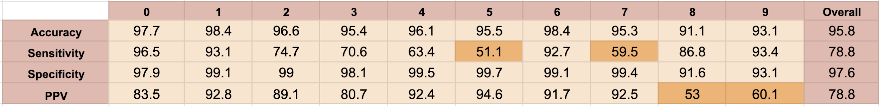
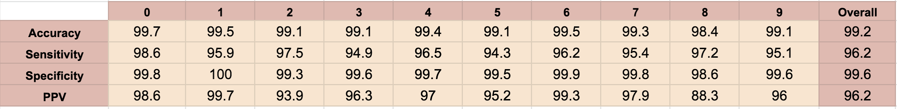
Astounding Insights!
Accuracy is not reliable. We know this! High false positives get hidden by very high false negatives
The PPV with Bayes classification after PCA is significantly higher than PPV before PCA
Bayes on 784 dimension
Bayes after PCA with 59 components

Slide 18
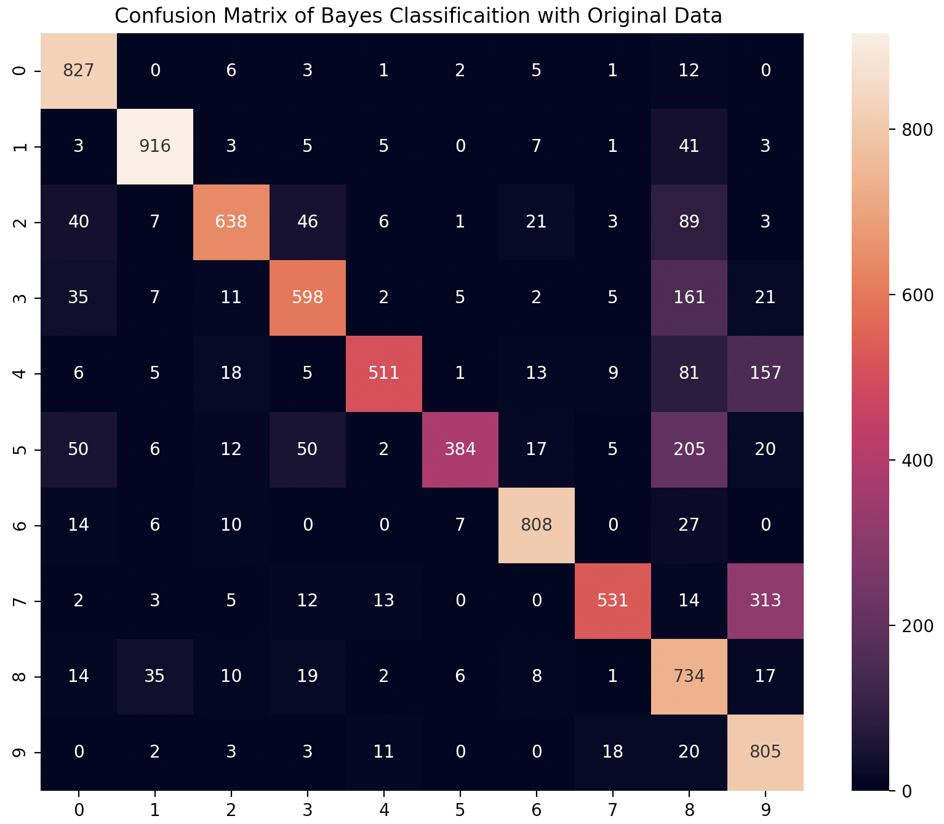
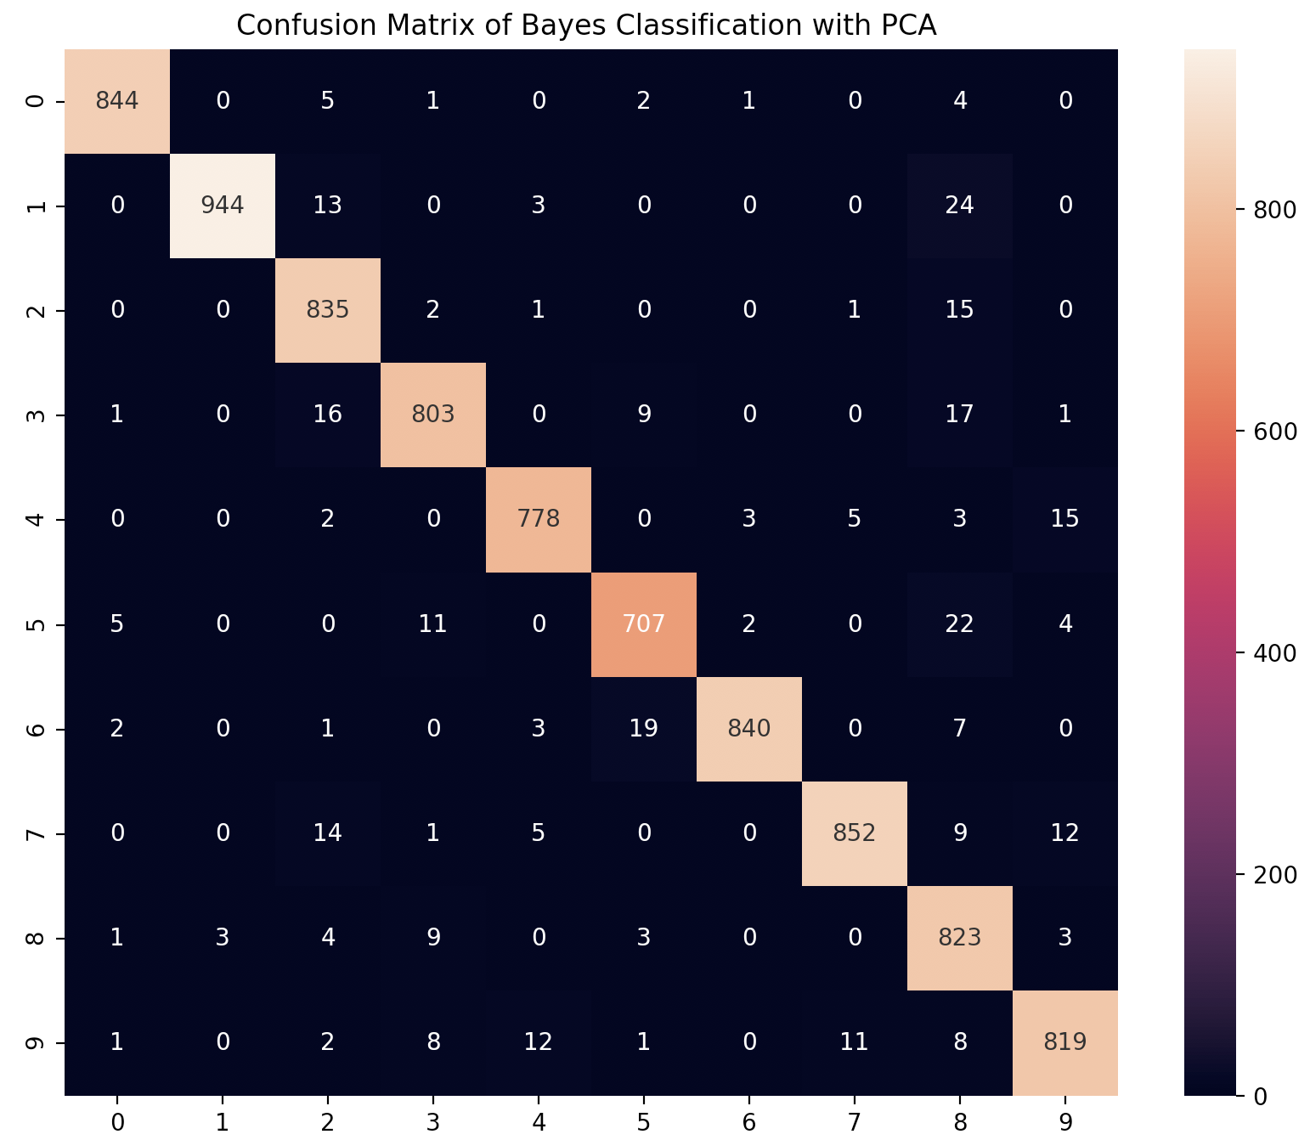
Astounding Insights!
Bayes on 784 dimension
Bayes after PCA with 59 components
Below is observed...
5 getting misclassified as 8
7 getting misclassified as 9
Sensitivity of 5 and 7 are low
PPV of 8 and 9 are low

Slide 19
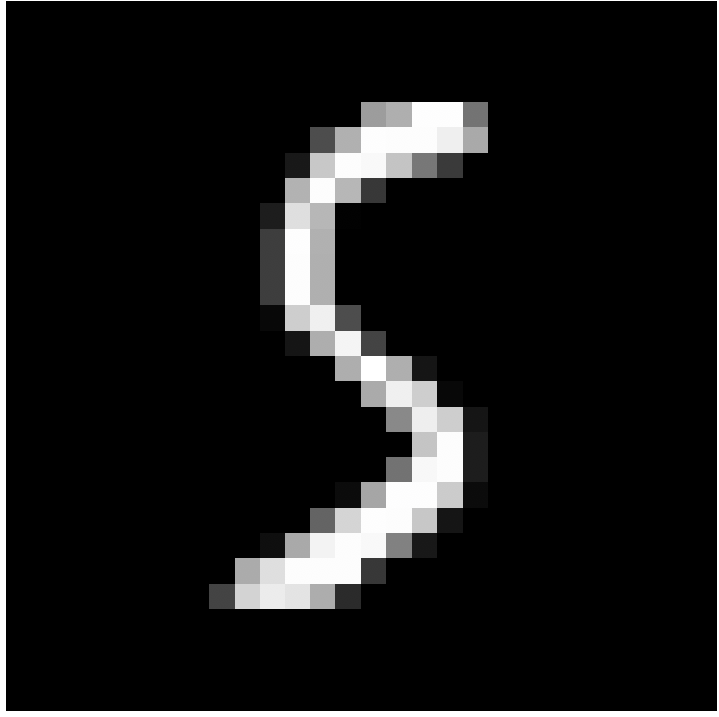

Astounding Insights!
Bayes on 784 dimension
5 misclassified as 8
Bayes after PCA with 59 components
5 classified as 5
Reasoning
Observed only with Bayes classifier
There seems to be an overfitting problem with using full data.
While PCA is not particularly a method to fix overfitting, in this case components with variance much larger than the effect of the noise are relatively unaffected by the noise

Slide 20
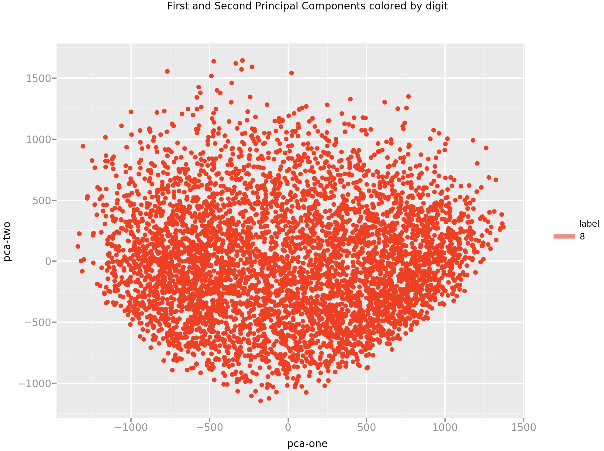
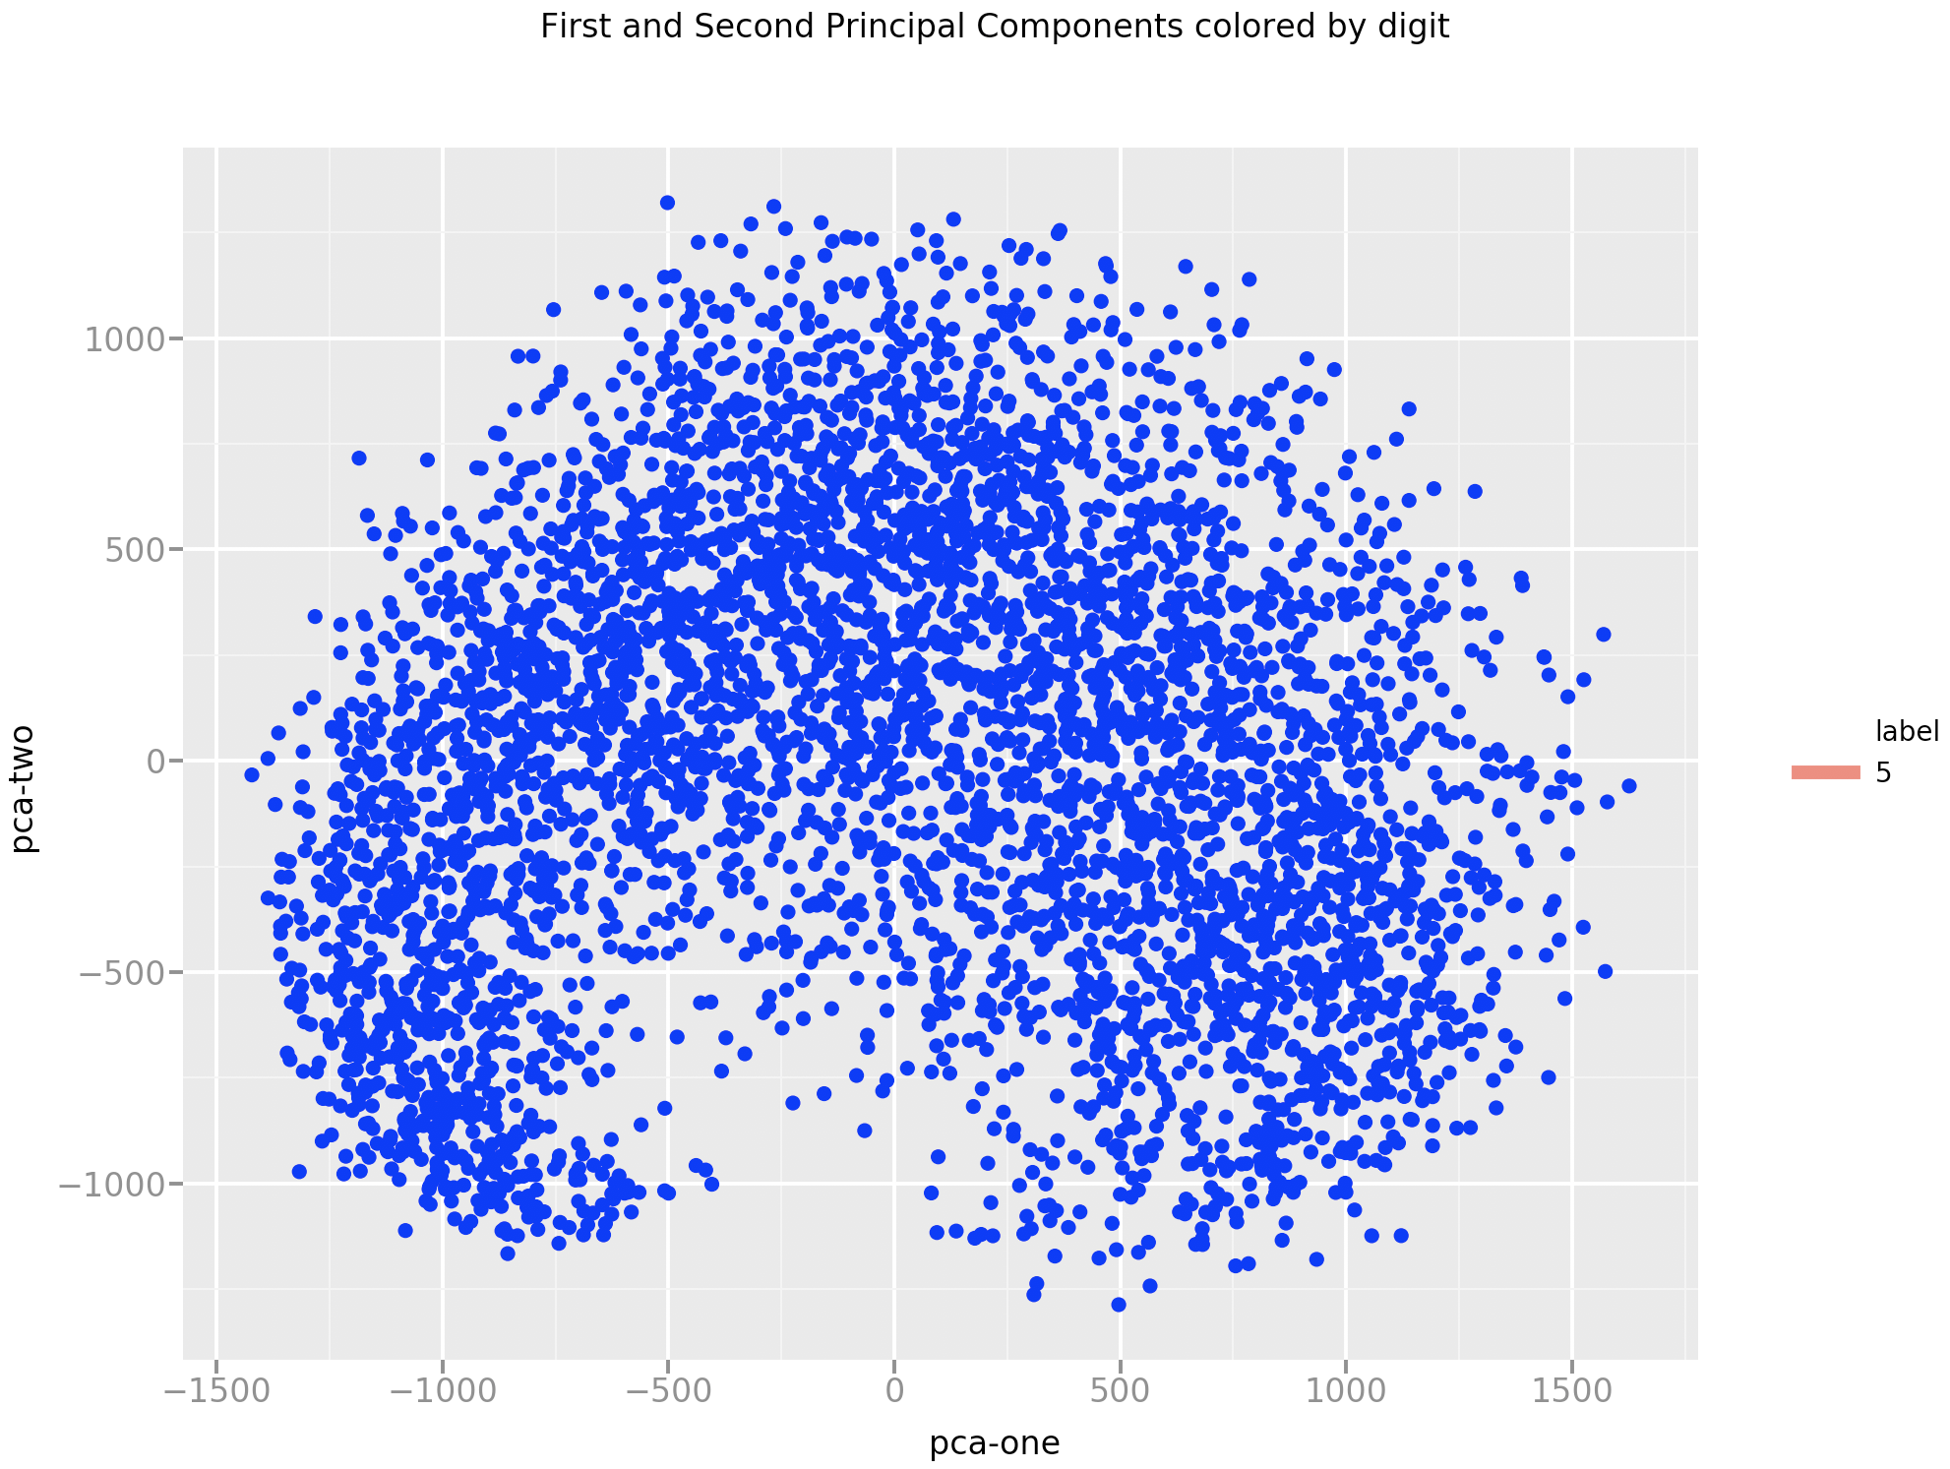
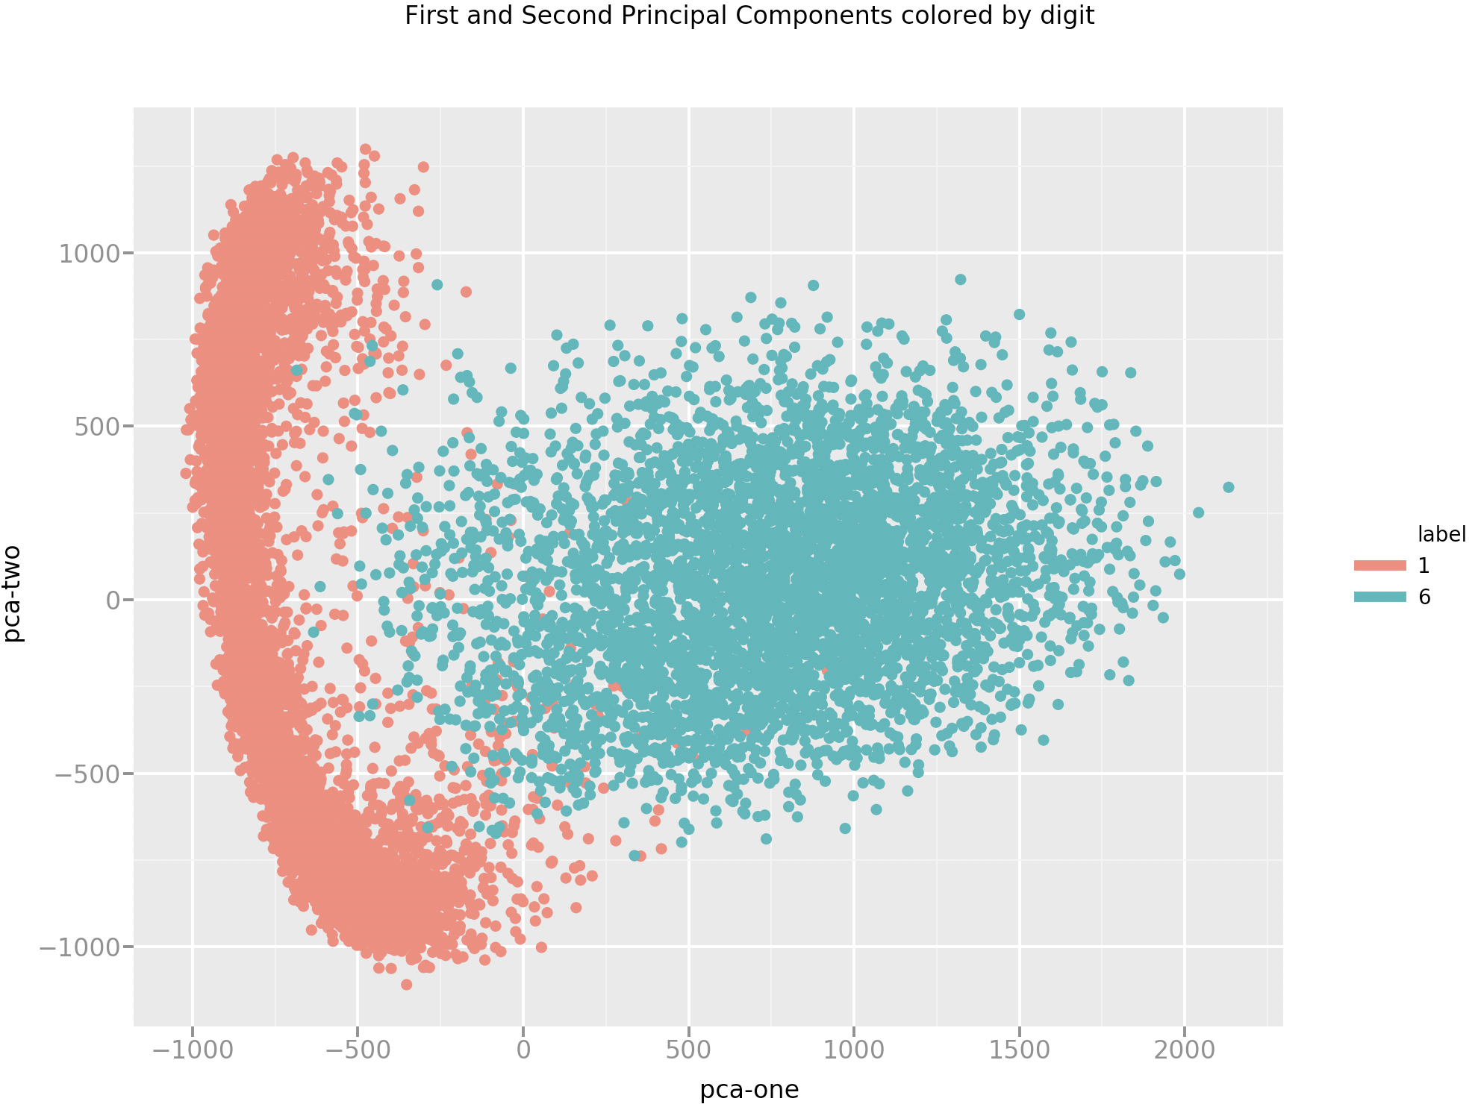
PCA Scatter plot - Some examples..
Digits
5 & 7
Digits 1 & 6

Slide 21
Interesting Facts
Linear classifier (pseudo inverse) gave a PPV of 55% clearly indicating lack of linear separability
Adding non linear quadratic dimension to the power 2 yielded a bump in PPV to 90%
 | Linear Classifier (Pseudo Inverse) | Linear Classifier quadratic power 2 (Pseudo Inverse)
PPV | 56% | 87%
Dimensions | 784 | 1830
Training time (ms) | 75 | 900
When tried for quadratic power 3, the training did not complete even after 15 minutes

Slide 22
Performance Metrics
* 784 dimensions, rest of the classifiers are run on the reduced dimensionality-PCA(59)
 | Accuracy | Sensitivity | Specificity | PPV
Full Bayesian | 99.2 | 96.17 | 99.57 | 96.22
Logit | 98.24 | 91.02 | 99.02 | 91.08
Neural Networks* | 91.37 | 80.15 | 81.09 | 73.21
Decision Tree | 96.75 | 83.42 | 98.2 | 83.48

Slide 23
Conclusion on classifiers
By no means we have tried all possible tuning across all classifiers
Goal was to bring out some interesting insights
With the minimal combinations tried out, we feel Bayes classification on over PCA worked best for the given MNIST dataset for a 10 class classification.
The reasoning thus far is that the distribution is highly gaussian in nature and PCA helped reduce noise to a certain extent leading to the highest PPV.

Slide 24
What we enjoyed ?
The main goal from the beginning was to try something more deeper.
We really enjoyed coming up with the technique for detecting multiple numbers and their bounding boxes.
We thoroughly enjoyed going one step further with some of the concepts studied in class and applying / learning in practice.
Definitely the outcome of Bayes classifier with PCA took us by surprise, main learning being when to use and not use them.

Slide 25


